Slide 1

Maven with Selenium-Part 1

Slide 2
Introduction
Maven is a project management and comprehension tool that provides developers a complete build lifecycle framework.
Maven is a software project management tool which provides new concept of project object model (POM).
Maven allows the developer to automate the process of the creation of the initial folder structure, performing the compilation and testing and the packaging and deployment of the final product.
Maven increases reusability and takes care of most of the build related tasks.

Slide 3
Features of Maven
Model-based builds − Maven is able to build any number of projects into predefined output types such as jar, war, metadata.
Coherent site of project information − Using the same metadata as per the build process, maven is able to generate a website and a PDF including complete documentation.
Release management and distribution publication − Without additional configuration, maven will integrate with your source control system such as CVS and manages the release of a project.
Backward Compatibility − It can easily port the multiple modules of a project into Maven 3 from older versions of Maven. It can support the older versions also.
Automatic parent versioning − No need to specify the parent in the sub module for maintenance.

Slide 4
6) Parallel builds − It analyzes the project dependency graph and enables you to build schedule modules in parallel.
7) Better Error and Integrity Reporting − Maven improved error reporting and it provides you with a link to the Maven wiki page where you will get full description of the error.
8) Simple project setup that follows best practices.
9) Consistent usage across all projects.
10) Dependency management including automatic updating.
11) A large and growing repository of libraries.
12) Extensible, with the ability to easily write plugins in Java or scripting languages.

Slide 5
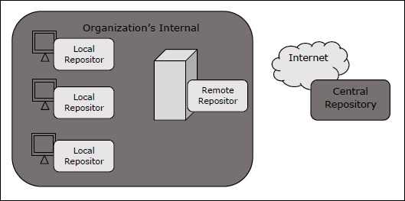
Maven Repository
A repository is a directory where all the project jars, library jar, plugins or any other project specific artifacts are stored and can be used by Maven easily.
The following three types of maven repository are:-
local
central
remote

Slide 6
1) Local repository:-
Maven local repository is a folder location on your machine. It gets created when we run any maven command for the first time.
Maven local repository keeps your project's all dependencies (library jars, plugin jars etc.). When you run a Maven build, then Maven automatically downloads all the dependency jars into the local repository.
2) Central repository:-
Maven central repository is repository provided by Maven community or managed by Maven community.
It contains a large number of commonly used libraries.
It is not required to be configured.
It requires internet access to be searched.

Slide 7
3) Remote repository:-Maven does not find a required dependency in central repository as well. It then stops the build process and output error message to console. To prevent such situation, Maven provides concept of Remote Repository, which is developer's own custom repository containing required libraries or other project jars.

Slide 8
Maven Build Lifecycle
A Build Lifecycle is a well-defined sequence of phases, which define the order in which the goals are to be executed.
Maven Build Lifecycle consists of the following sequence of phases are:-
Phase | Handles | Description
prepare-resources | resource copying | Resource copying can be customized in this phase.
validate | Validating the information | Validates if the project is correct and if all necessary information is available.
compile | compilation | Source code compilation is done in this phase.
Test | Testing | Tests the compiled source code suitable for testing framework.
package | packaging | This phase creates the JAR/WAR package as mentioned in the packaging in POM.xml.
install | installation | This phase installs the package in local/remote maven repository.
Deploy | Deploying | Copies the final package to the remote repository.

Slide 9
Maven POM
POM is Project Object Model XML file that contains information about the project and configuration details used by Maven to build the project.
Some of the configuration that can be specified in the POM are the project dependencies, the plugins or goals that can be executed, the build profiles and so on.
All POM files require the project element and three mandatory fields: groupId, artifactId, version.
Sr.No. | Node | Description
1 | Project root | This is project root tag. You need to specify the basic schema settings such as apache schema and w3.org specification.
2 | Model version | Model version should be 4.0.0.
3 | groupId | This is an Id of project's group. This is generally unique amongst an organization or a project.
4 | artifactId | This is an Id of the project. This is generally name of the project. The artifactId defines the artifact's location within the repository.
5 | version | This is the version of the project. Along with the groupId, It is used within an artifact's repository to separate versions from each other.

Slide 10
Covered Till Now
Maven is a project management and comprehension tool that provides developers a complete build lifecycle framework.
Features of Maven
Maven Repository
Maven Build Lifecycle
Maven POM

Slide 11
Thanks

